Slide 1
Final Engagement
Attack, Defense & Analysis of a Vulnerable Network

Slide 2
Table of Contents
This document contains the following resources:
Network Topology & Critical Vulnerabilities
Exploits Used
Proof of Exploitation
Suggested System Hardening

Slide 3

Network Topology
& Critical Vulnerabilities
‹#›

Slide 4
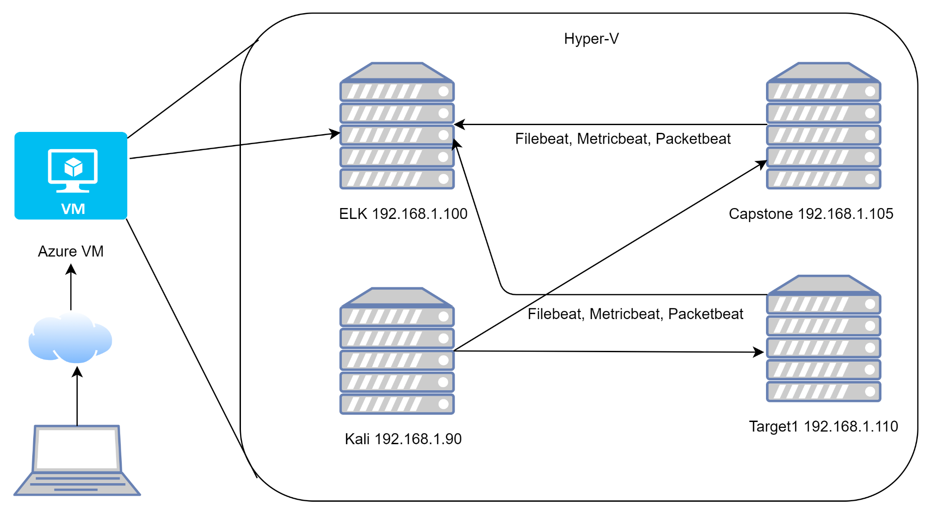
Network Topology
Network
Address Range: 192.168.1.0/24
Netmask: 255.255.255.0
Gateway: 192.168.1.1
Machines
IPv4: 192.168.1.100
OS: Linux
Hostname: ELK
IPv4: 192.168.1.90
OS: Linux
Hostname: Kali
IPv4: 192.168.1.105
OS: Linux
Hostname: Capstone
IPv4: 192.168.1.110
OS: Linux
Hostname: TARGET1

Slide 5
Critical Vulnerabilities: Target 1
Our assessment uncovered the following critical vulnerabilities in Target 1.
Vulnerability | Description | Impact
Weak Passwords | Same as username, or easily cracked using John the Ripper | Exposed open ports & services and two users.
SSH Remote Login | Very open ability to ssh remote login | Gain two different user shells
Sensitive Data Breach | SQL database login information | SQL Usernames and password hashes
Privilege Escalation with Remote Code Execution | Sudo privileges for python | Ability to gain root

Slide 6
Exploits Used
‹#›

Slide 7
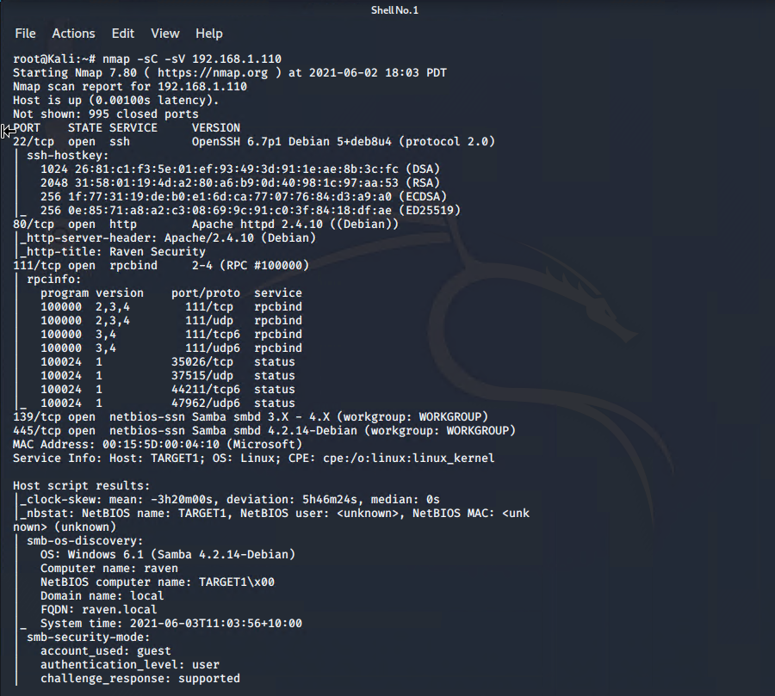
Prework for Exploitation: Active Site Reconnaissance
Nmap was used to actively scan the network and Target 1 machine was identified at 192.168.1.110.
SSH is open on port 22, and HTTP is open on port 80. Ports 111, 139 and 445 were also open.

Slide 8
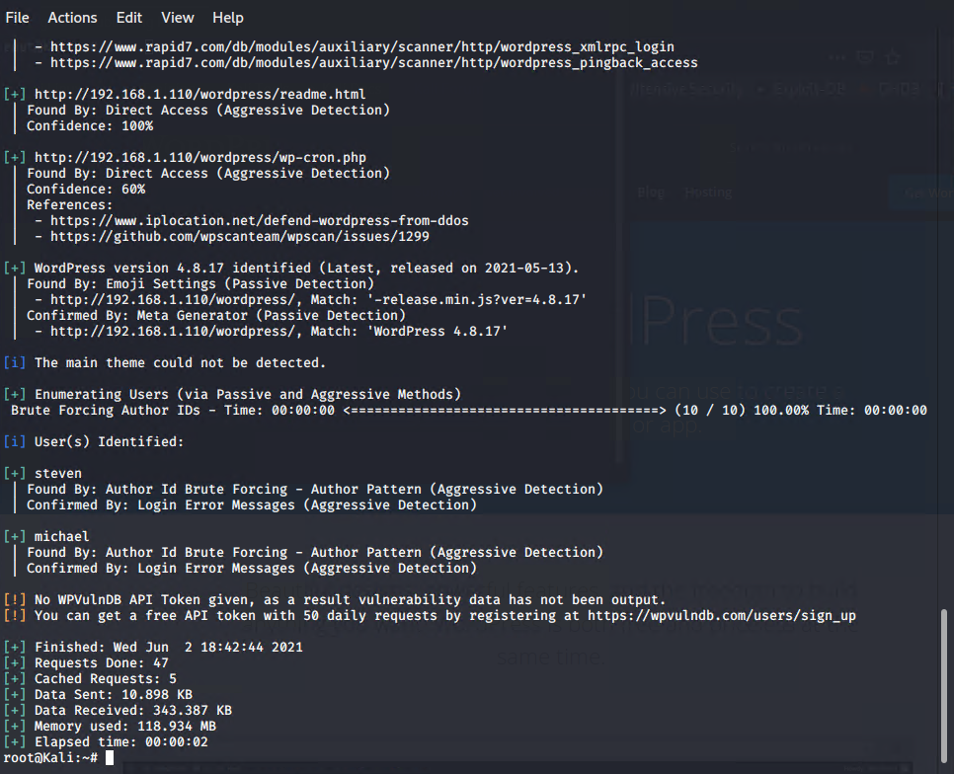
Prework for Exploitation: WordPress Name Enumeration
wpscan was used to identify any wordpress vulnerabilities.
Two users were identified: michael and steven

Slide 9
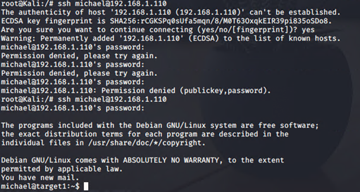
Exploitation: Weak Passwords
Overview of Exploitation:
Using a known users name and guessing simple passwords (i.e. 123456, password, admin, etc) and using John the Ripper to crack a user hash.
User shell was obtained for two user accounts: michael/michael; steven/pink84.

Slide 10
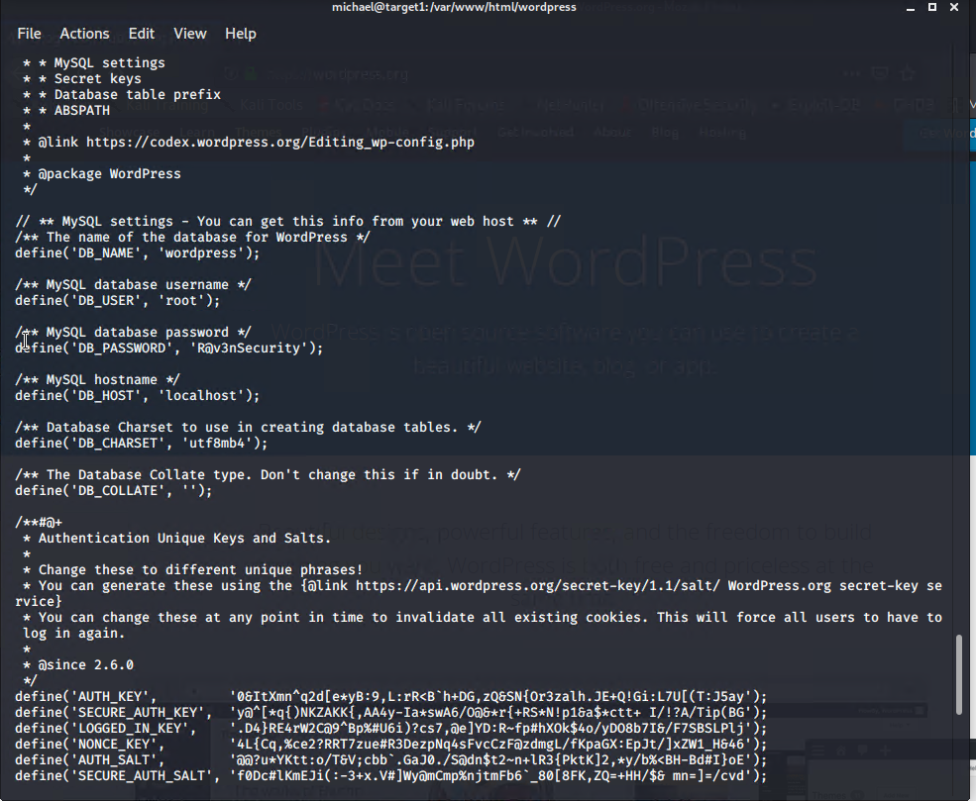
Exploitation: SSH Login with Simple Brute Force
Overview of Exploitation:
From the Kali machine user shell was obtained using ssh michael@192.168.1.110 and utilizing guessed password michael.
MySQL database name and login credentials were discovered in files accessible with michael’s permission.

Slide 11
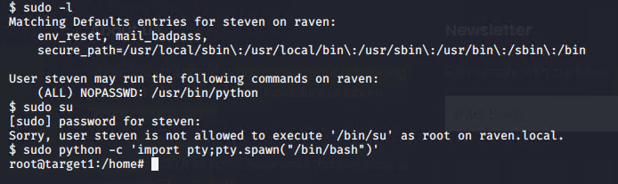
Exploitation: Privilege Escalation with Remote Code Execution
Overview of Exploitation:
Checking sudo users, identified steven as having /usr/bin/python privilege with no password required.
Root was obtained by running command
sudo python -c 'import pty;pty.spawn("/bin/bash")'

Slide 12
Proof of Exploitation
‹#›

Slide 13
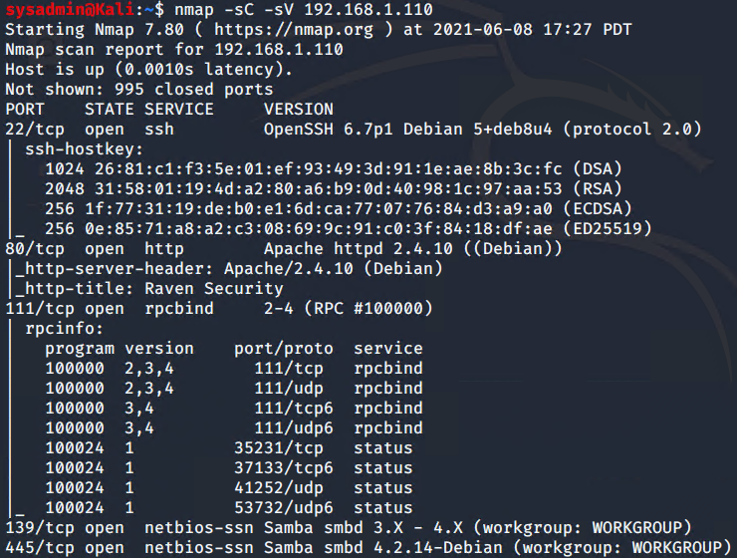
NMap
Scan using: nmap -sC -sV 192.168.1.110

Slide 14
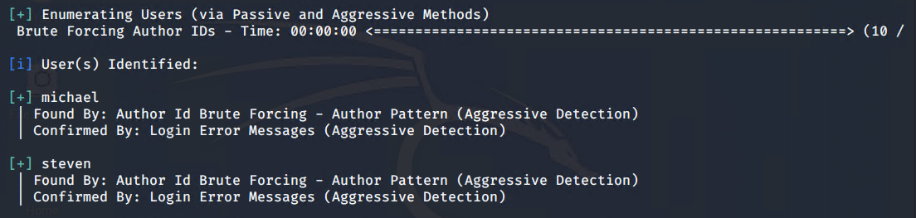
WPScan
wpscan --url http://192.168.1.110/wordpress --enumerate u

Slide 15
SSH Login

Slide 16
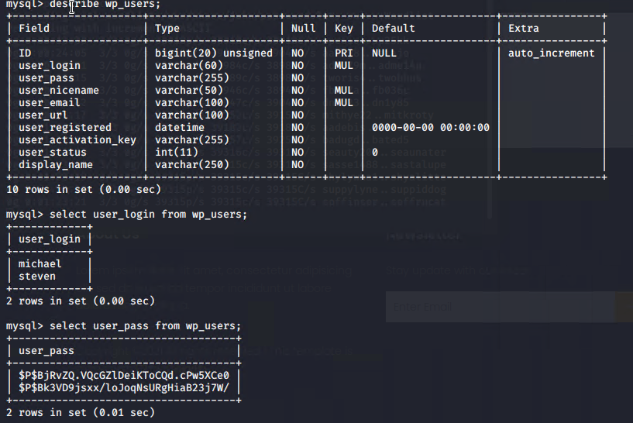
Sensitive Data Exposure
SQL Database Name, User and Password; SQL Users and Password Hashes

Slide 17
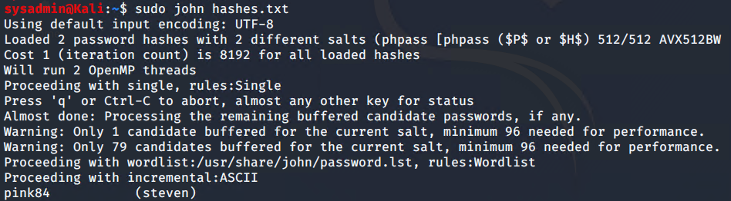
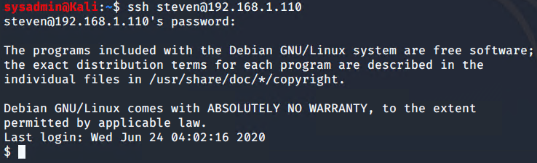
Cracking Passwords, Logging in as more privileged user
Using John the Ripper to crack password hashes
SSH with steven’s password confirming login

Slide 18
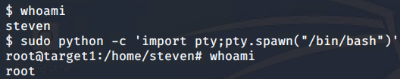
Privilege Escalation via Python Sudo Privileges
Using sudo -l identified steven with /usr/bin/python privileges
Gained root using Python command:
sudo python -c ‘import pty;pty.spawn(“/bin/bash”)’

Slide 19
Suggested System Hardening
‹#›

Slide 20
Suggested System Hardening
Weak Passwords
Patch: Install multi factor authentication and a strong password policy.
Why It Works: Longer and more complex passwords are significantly harder to guess or brute force. Multi factor authentication is even more secure.
SSH Remote Login
Patch: Remove SSH and close port 22, unless actually needed. If it is needed, install a firewall rule that it is only accessed from specific white listed IP addresses.
Why It Works: Either completely removes access via port 22, or limits access to known IP addresses that are deemed safe.

Slide 21
Suggested System Hardening
SUDO Privileges & File Access
Patch: Remove sudo privilege unless actually needed. chmod 700 to these files.
Why It Works: It removes the possibility of remote code execution to escalate privileges to root.
Brute Force & DoS Attack
Patch: Install an IPS (Intrusion Prevention System) that would block traffic coming from suspicious IPs.
Why It Works: By taking action once an intrusion is detected, the IPS can react faster than waiting for human intervention or later detection.

